Slide 1

Tipling / BTO
Integrating citizen science data to estimate bird population trends
Philipp Boersch-Supan @pboesu
British Trust for Ornithology @_BTO

Slide 2


How do we count UK breeding birds?
Breeding Bird Survey (BBS)
strict count protocol of all birds encountered
line transects, distance sampling, known survey effort
randomized site selection, high coverage (1.66% of UK!)
Big data (25 years, >4000 sites)
(but not big enough for many species of conservation concern)
BirdTrack (and similar schemes)
complete listing optional
counting optional
effort recording optional
sites self-selected
Bigger data (currently ~15k sites, ~100k lists per year)

Slide 3
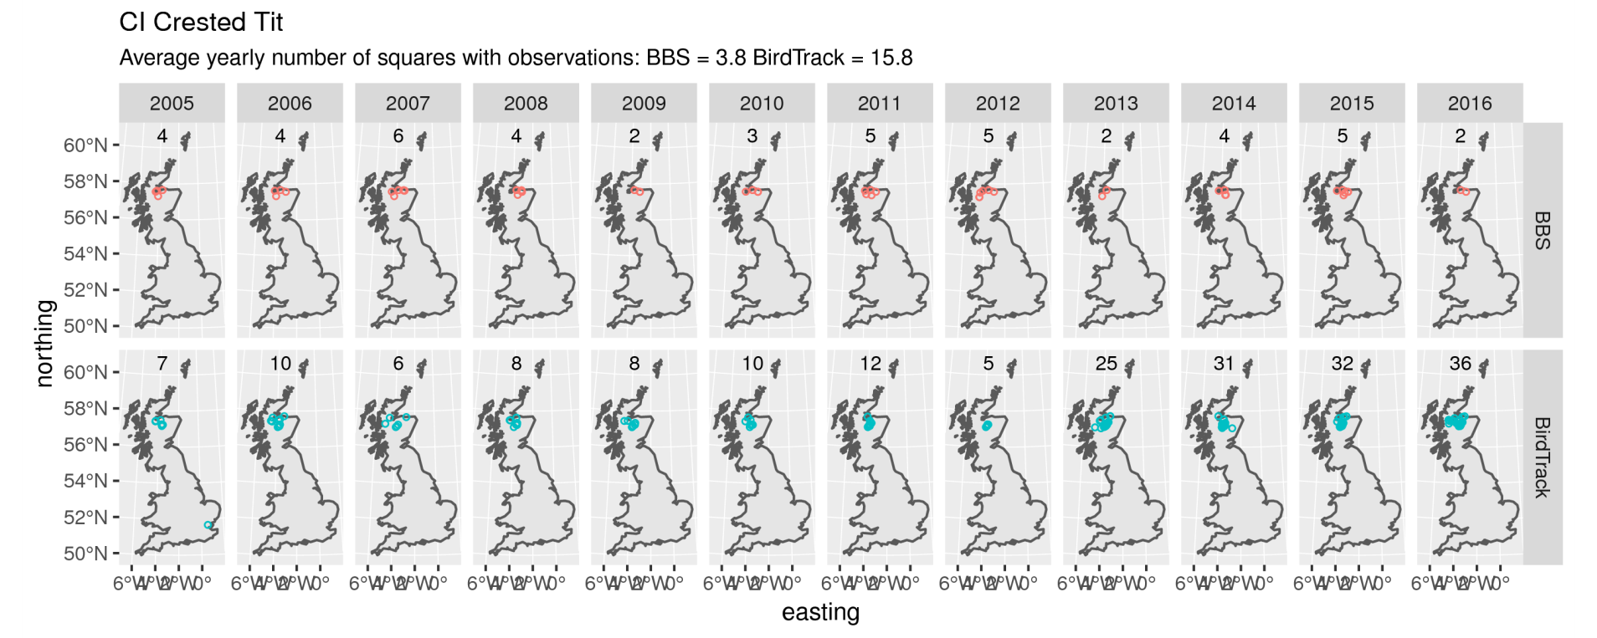
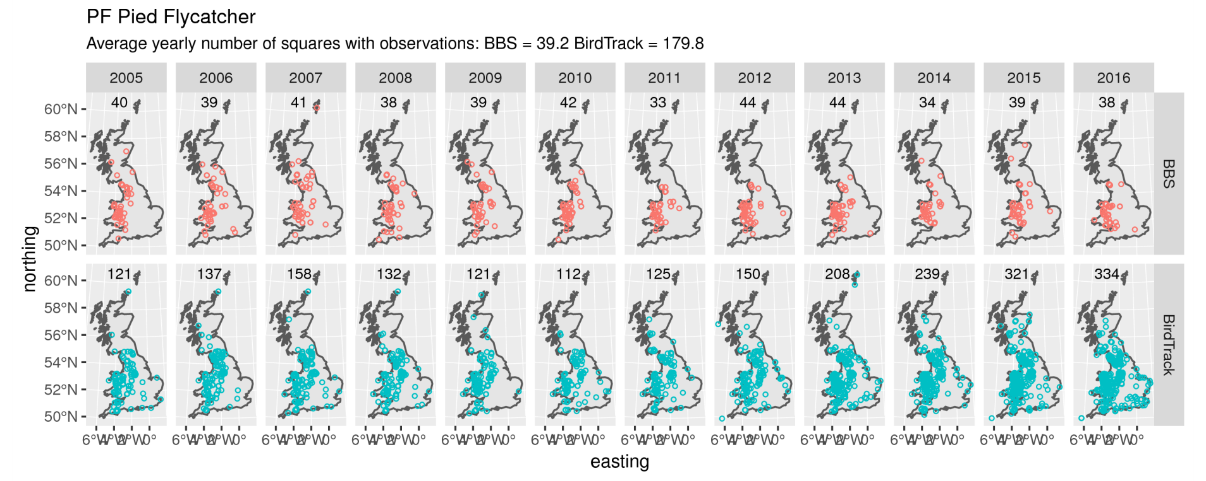
 BirdTrack has c. 10x more records across space
Crested Tit
Pied Flycatcher

Slide 4
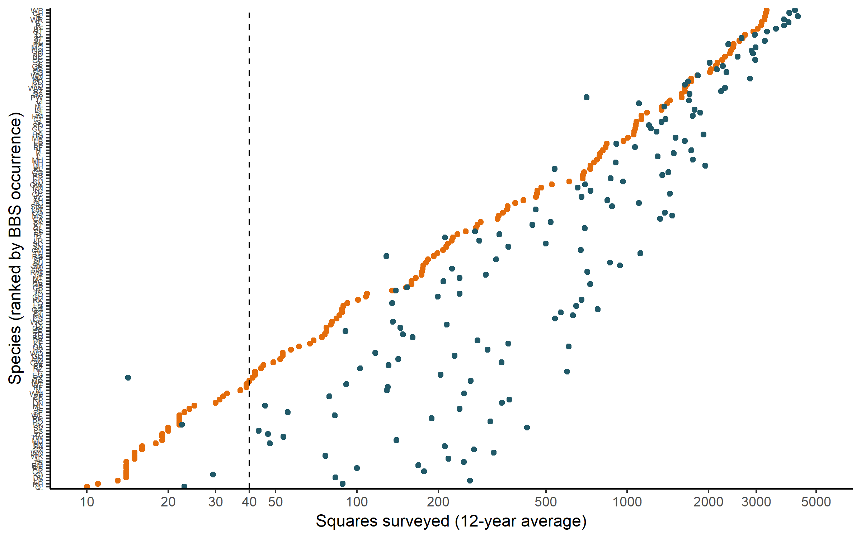
 BirdTrack has c. 10x more records across space
BirdTrack captures species in many more places than the BBS
No BBS trend reported
BBS sample size reporting threshold
BBS locations
BirdTrack locations
No BBS trend reported
e.g. Lesser Spotted Woodpecker, Nightingale,
Hen Harrier, Pied Flycatcher, Woodcock

Slide 5
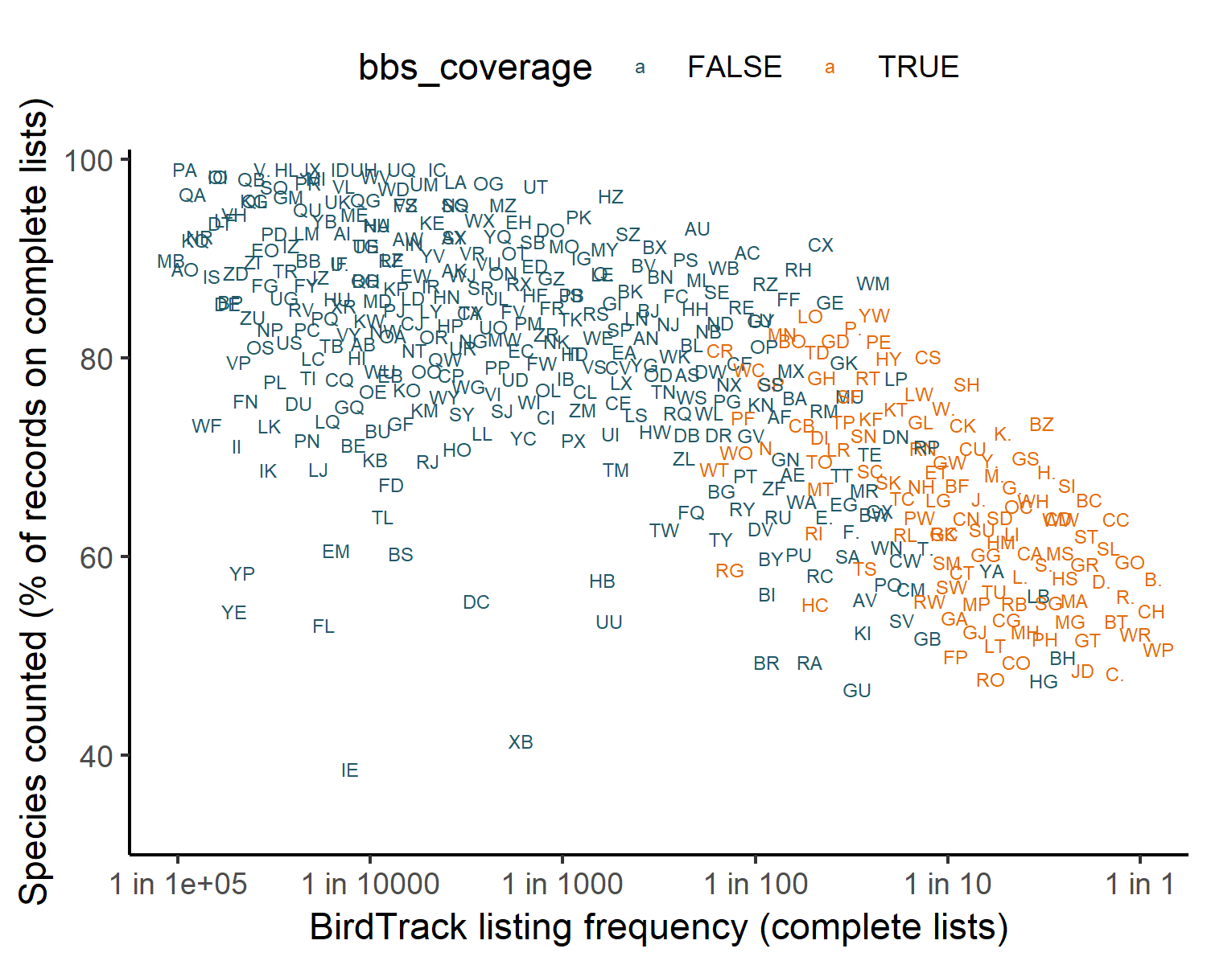
 BirdTrack users don’t count all species
Common species are less likely to be counted by BirdTrack users
BBS trends
available
No BBS trends
available

Slide 6
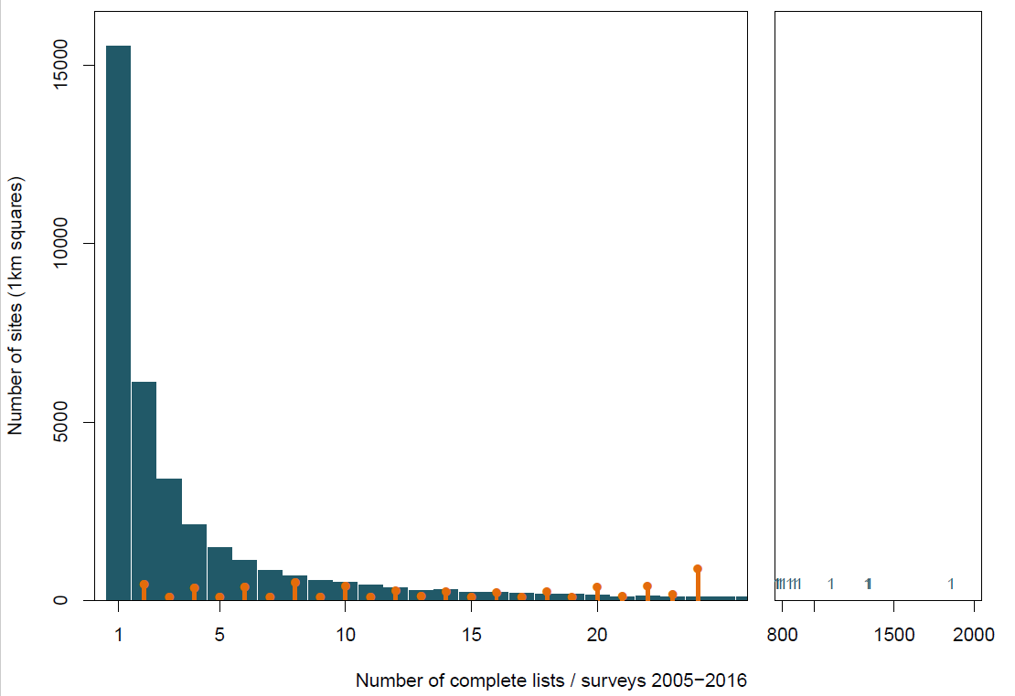
 Most BirdTrack sites are one-offs
Most BirdTrack sites are rarely revisited, a few very often
BirdTrack locations
BTO Headquarters
BBS locations

Slide 7
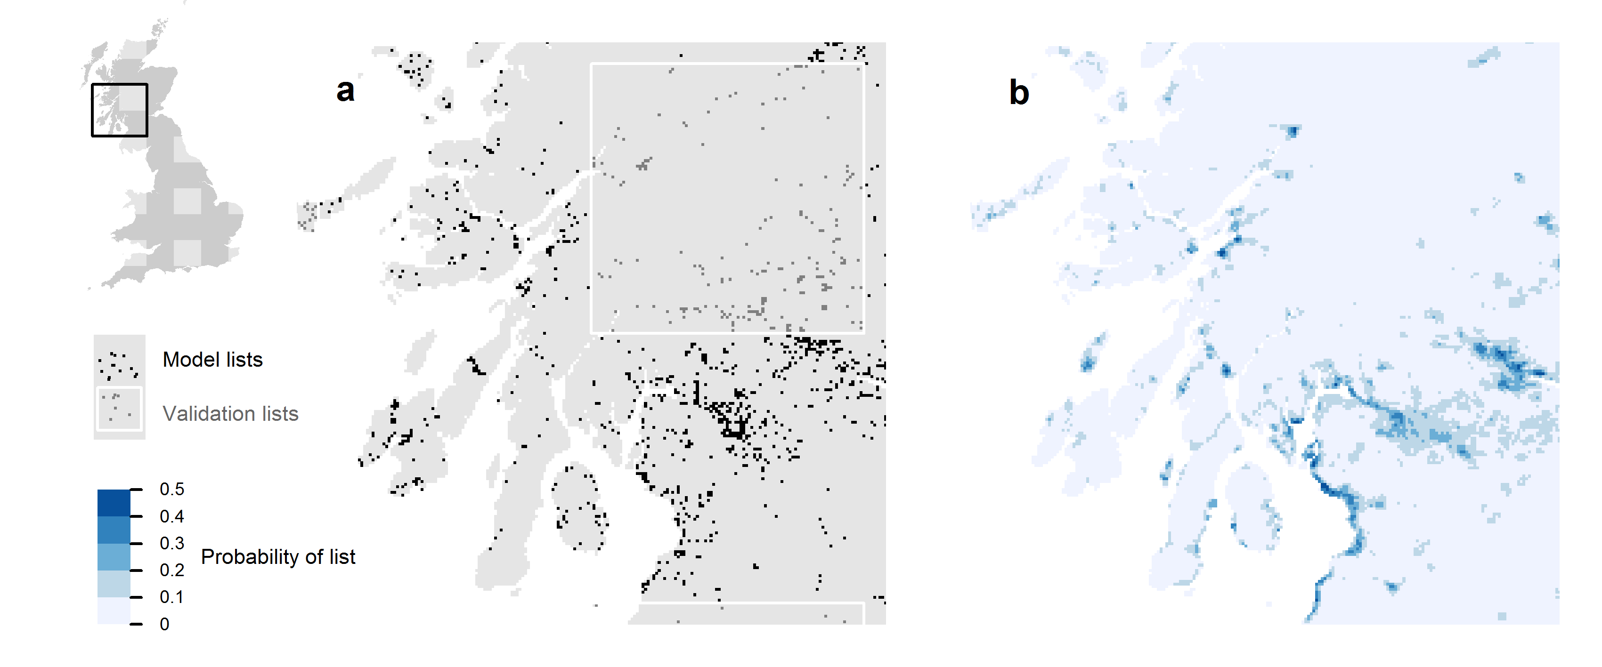
 BirdTrack sites are not randomly selected
BirdTrack sites are biased towards urban areas, coasts, reserves
Johnston et al. in review

Slide 8
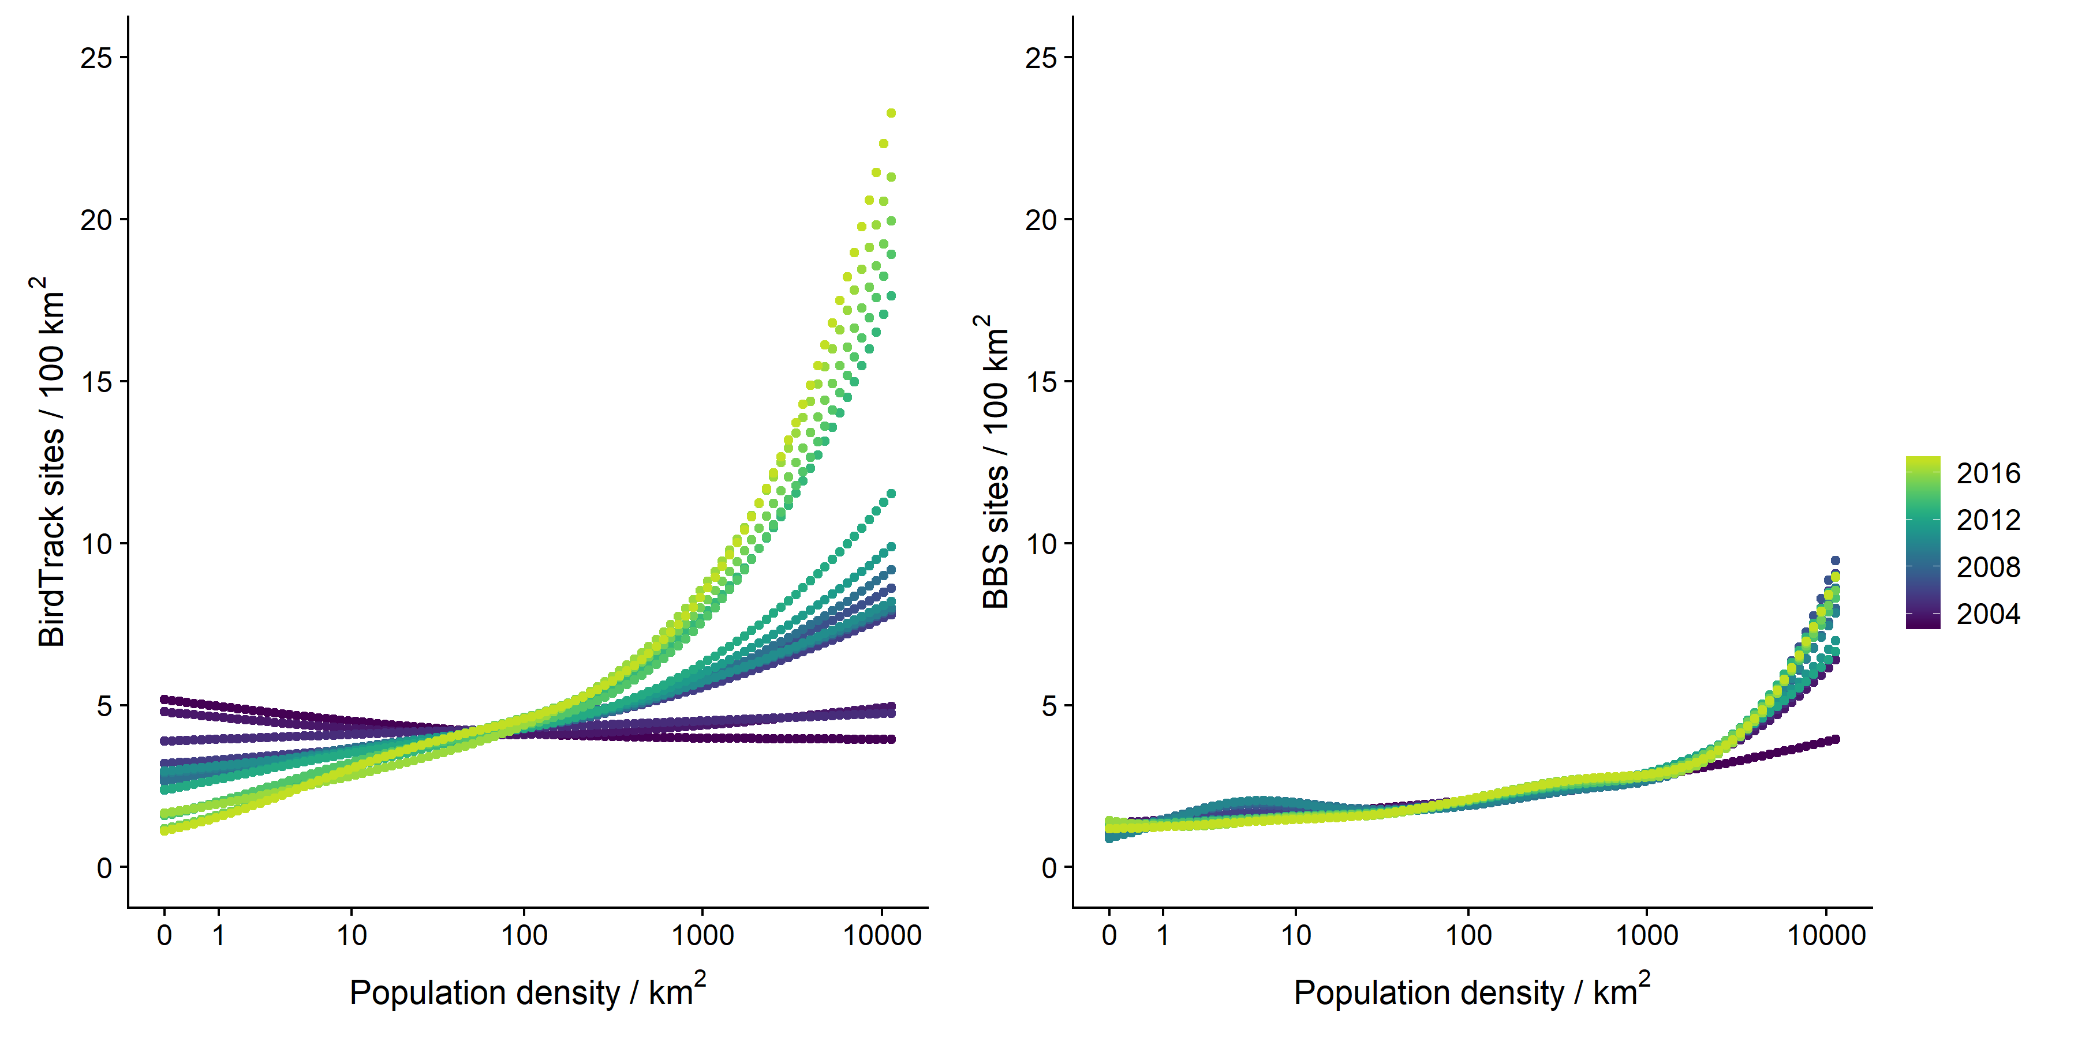
 Site selection bias is non-stationary
BirdTrack spatial bias is increasingly urban
BirdTrack
BBS
Boersch-Supan et al. in prep.

Slide 9
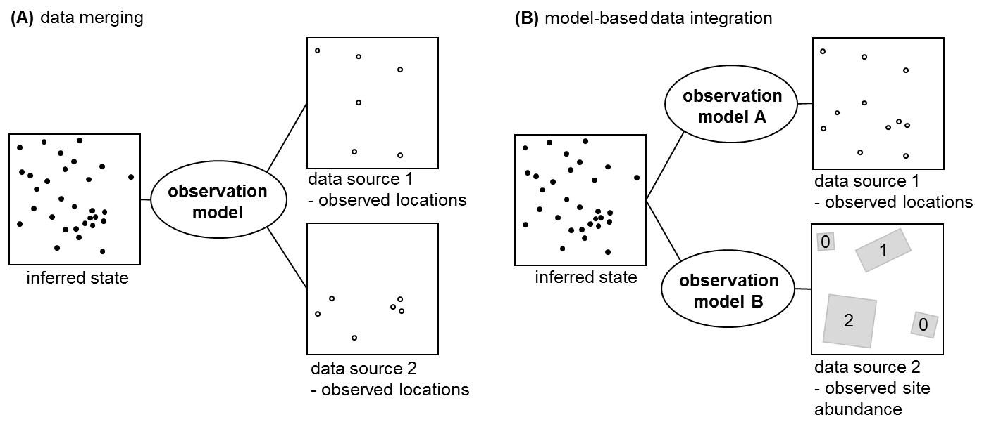
How do we integrate these data?
Isaacs et al. in revision at TREE, see also Miller et al. 2019 MEE, Zipkin et al 2019 Ecology, Pacifici et al. 2019 Ecology

Slide 10
True species distribution
Observation error
Observed data
Latent state
time
locations of individuals
random site selection imperfect detection of individuals
1
1
0
1
0
✓
1
2
0
1
0
1
3
2
3
1
✓
1
7
7
truncate
counts
✓
unbiased counts
but “small” sample size
4
0
2
0
2
✗
4
0
2
0
2
0
0
0
0
true site abundance
BBS site abundance
BBS site occurrence
✓
✓
biased site selection
imperfect detection of species
✗
✓
✓
✗
✓
✓
✓
✗
✓
✓
biased (non)detections
large sample size
✓
✗
✓
✗
✓
✗
✓
✗
✓
✗
✓
✗
true site occupancy
BirdTrack list record
after Isaacs et al. in revision at TREE

Slide 11
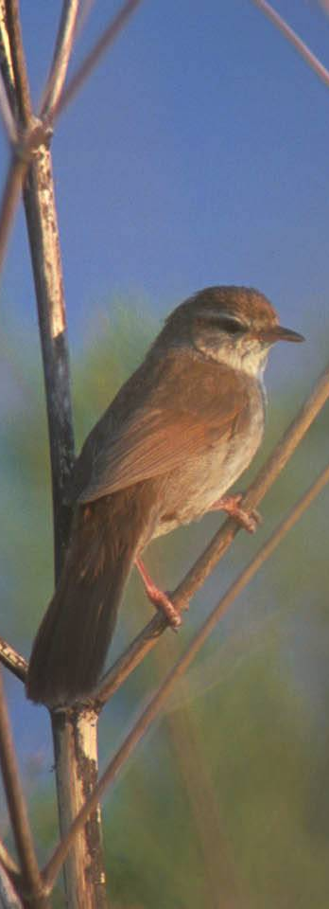
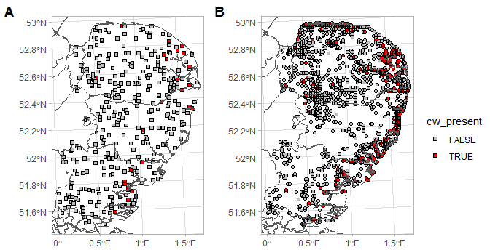

Integrated state-space model for Cettia cetti
Neil Calbrade/BTO

Slide 12
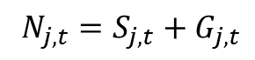
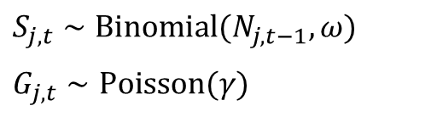
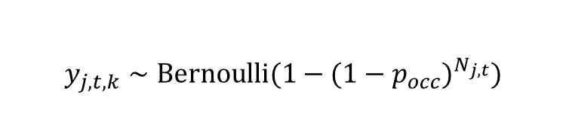

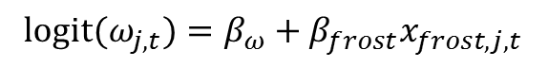
Integrated model following Zipkin et al. 2018; Parameter estimation via MCMC
State model: True abundance = Survival + Recruitment
Latent state
$N_{j,t}=S_{j,t}+G_{j,t}$
$$S_{j,t}∼Binomial(N_{j,t−1},ω)$$
$$G_{j,t}∼Poisson(γ)$$
$logit(ω_{j,t})=β_{ω}+β_{frost}x_{frost,j,t}$
random site selection imperfect detection of individuals
$$n_{j,t,k}∼Binomial(N_{j,t},p)$$
1
1
0
1
Count observations: N-mixture model
1
2
0
1
3
2
3
1
7
7
4
0
2
0
4
0
2
0
0
0
true site abundance
BBS site abundance
✓
biased site selection
imperfect detection of species
✗
✓
✓
✗
✓
✓
✓
✗
✓
✓
✓
$$y_{j,t,k}∼Bernoulli(1−(1−p_{occ})^{N_{j,t}})$$
Species list observations:
✓
✗
✓
✗
✓
✗
✓
✗
✓
✗
✓
✗
true site occupancy
BirdTrack list record
Boersch-Supan et al. in prep., Zipkin et al. 2018 Ecology

Slide 13
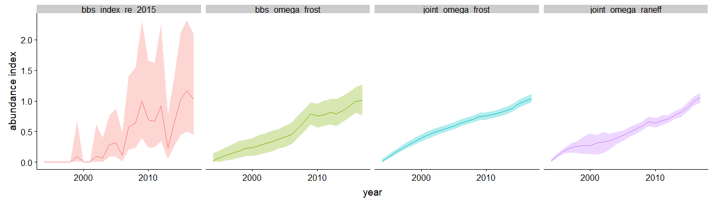
Initial results for Cettia cetti
weather-driven survival
year-effect survival
current BBS model
BBS state-space
Integrated state-space models
big improvement in precision for abundance trend
good agreement with data from Rare Breeding Birds Panel
computational effort is high
too high for routine UK-scale applications
but country-level joint trends are in reach
Boersch-Supan et al. in prep

Slide 14
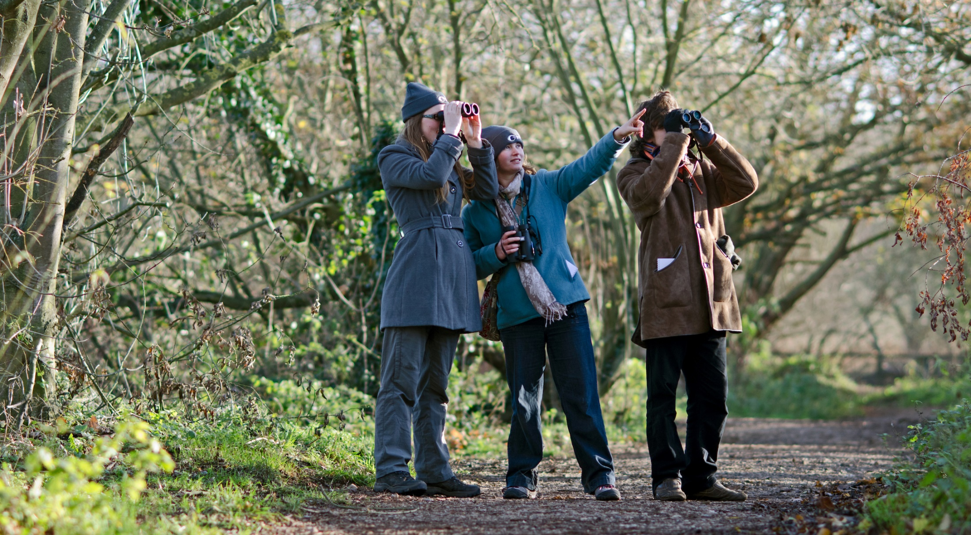
Tipling / BTO
This analysis was only possible with the dedication of the thousands of BBS volunteers and BirdTrack users, the contributors to the BirdTrack Appeal, and the survey partners. Computations were conducted on NERC’s JASMIN data analysis platform.

Slide 15
Data
BBS
Abundance trends: maximum annual count per site
Occurrence trends: detection-nondetection based on max. count
BirdTrack
species detection-nondetection
complete, timed lists with a 1km grid reference
recorded in BBS survey window (April – June)
Locations with <2 lists removed for trend calculation
n_{lists} = 321,901; n_{locations} = 22568
Analysis timeframe: 2005 – 2016
Species set: 141 species that are reasonably covered by BBS
Boersch-Supan et al. submitted

